Slide 1
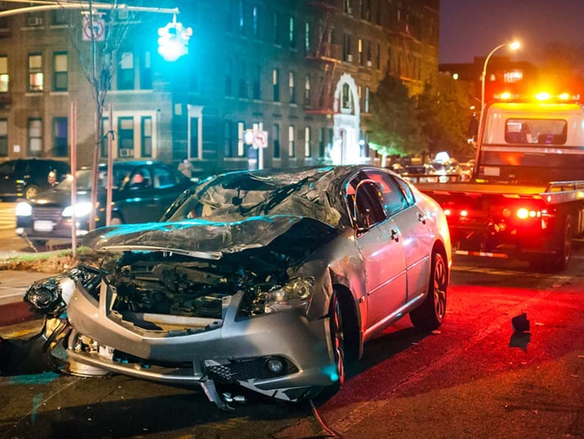
Michigan Accidents DSA6000
Group Members: Ameen Alkhabbaz Jordan Burton David Emery George Mckenzie Mahzad Zavareh

Slide 2
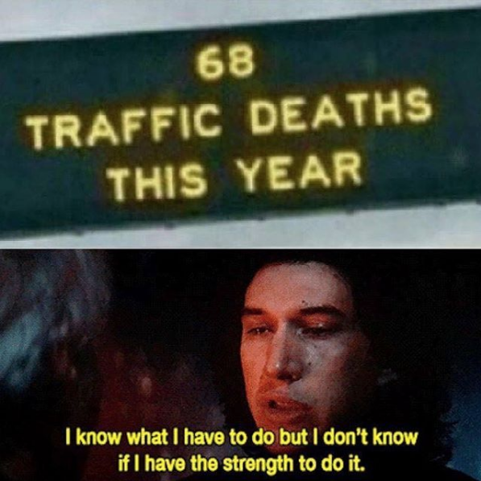

Slide 3
County (City)​ | Total Accidents​ | Population | Accidents Per Capita
Genesse (Flint) | 27,072 | 410,881 | 6.59%
Wayne (Detroit) | 22,214 | 1,763,822 | 1.26%
Kent (Grand Rapids) | 12,989 | 636,376 | 2.04%

Slide 4
Wayne
Genesee
Kent

Slide 5
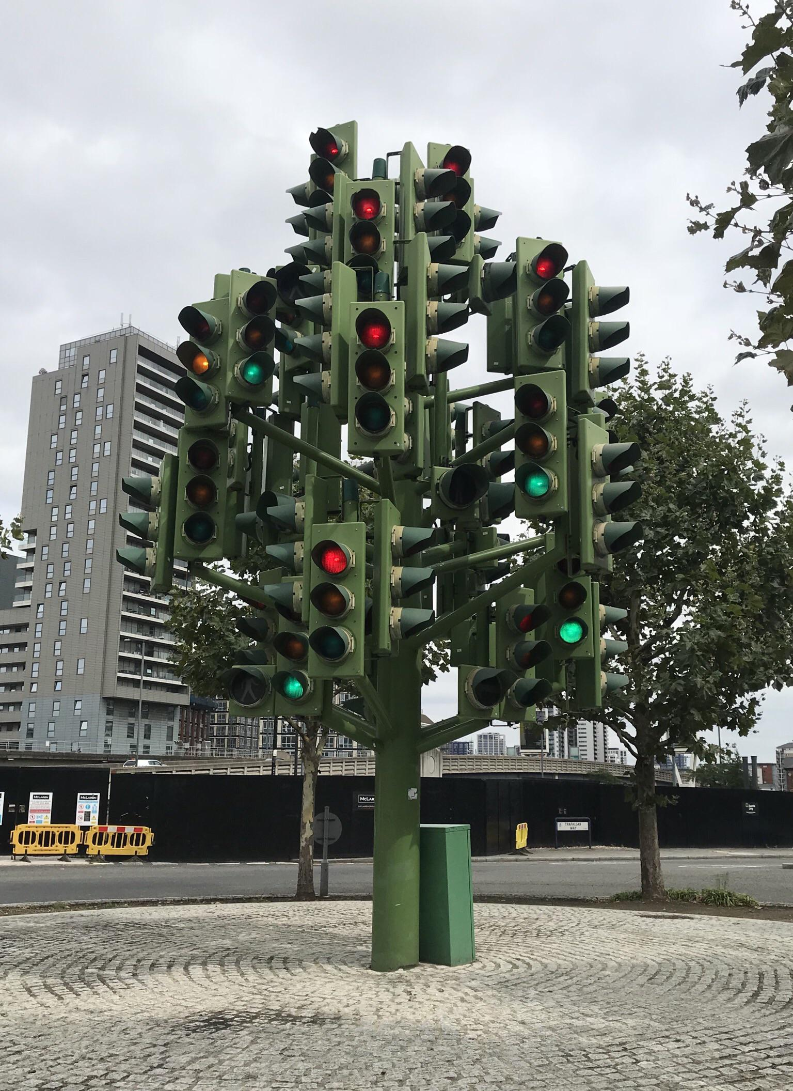

Slide 6
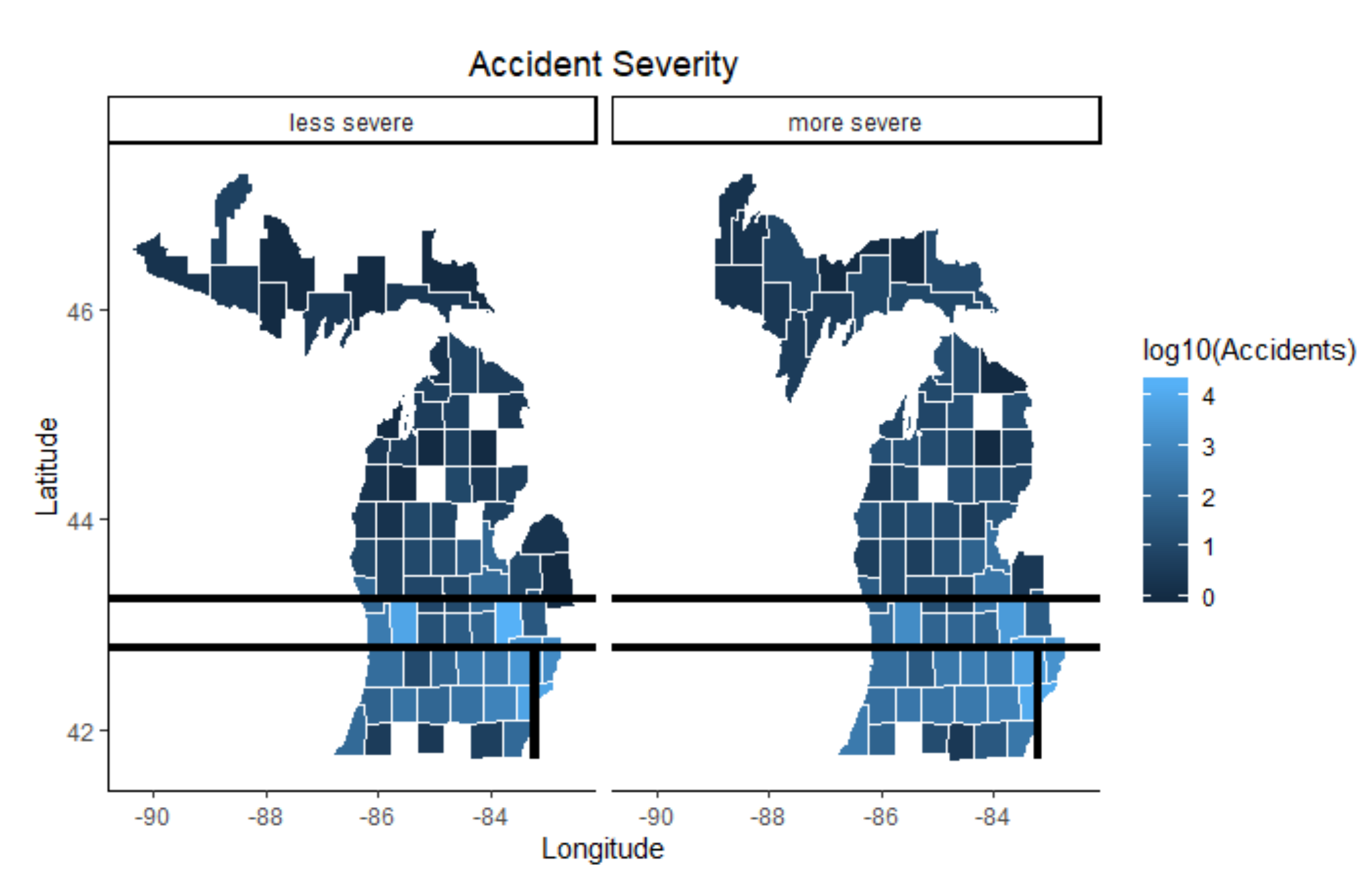

Slide 7
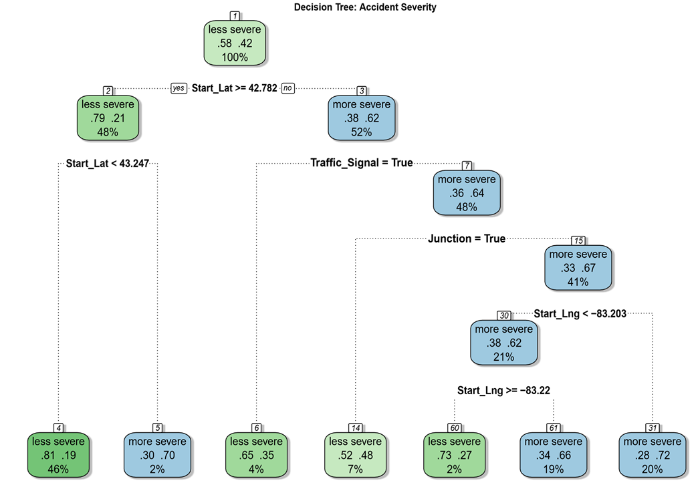

Slide 8
Genesee
(Flint)
Genesee
(Flint)
Genesee
(Flint)
Genesee
(Flint)

Slide 9
Genesee (Flint)
I-75 at Exit 118

Slide 10
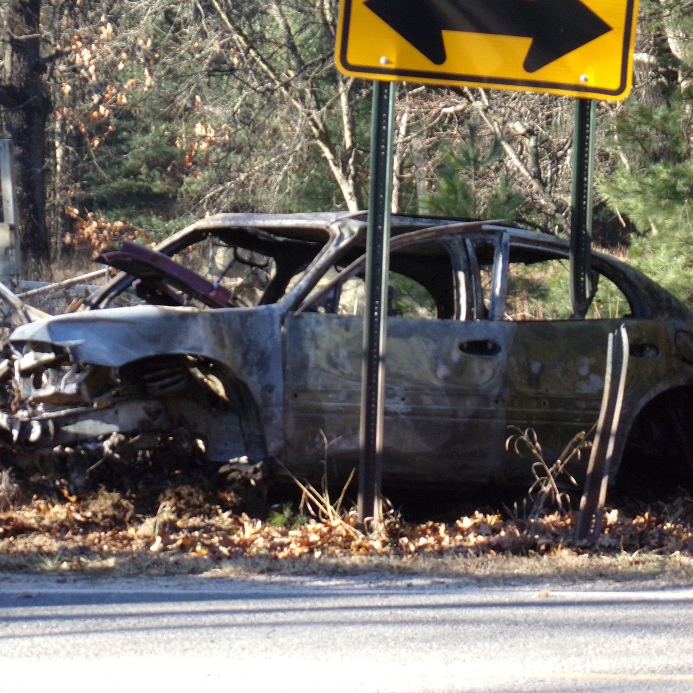
Key Takeaways:
Mapping helpful for identifying patterns in the data
Congestion in population centers (Detroit, Genessee, Flint) key element of accident volume and severity
Problematic location identified in Flint I-75 at Exit 118

Slide 11
Thank You

